Slide 1


Introduction to Hadoop:
A Foundation for Big Data
Welcome to our exploration of Hadoop, a cornerstone in the world of Big Data. Hadoop is a powerful, open-source framework designed to handle massive datasets. It's not just about storage; it's about processing, analyzing, and extracting valuable insights from data that would overwhelm traditional systems. At its core, Hadoop offers a distributed file system (HDFS) and a processing engine (MapReduce) for parallel processing, enabling you to work with terabytes and even petabytes of data efficiently. Let's delve into the key components and capabilities that make Hadoop such a vital tool for organizations across various industries.

Slide 2

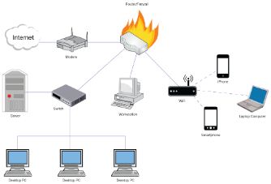
Understanding the Hadoop Ecosystem
1
HDFS: The Foundation
2
MapReduce: Parallel Processing Powerhouse
HDFS (Hadoop Distributed File System) serves as the backbone of Hadoop. It's a fault-tolerant, scalable file system designed to store vast amounts of data across a cluster of machines. Think of it as a robust library for your Big Data.
MapReduce is the engine that drives data processing in Hadoop. It enables parallel computation, breaking down complex tasks into smaller, independent units that can be executed concurrently on multiple nodes.
3
YARN: The Resource Manager
4
Hive, Pig, and HBase: Tools for Data Exploration and Analysis
YARN (Yet Another Resource Negotiator) acts as a central coordinator for Hadoop. It manages resources, allocating them to different applications running within the Hadoop cluster. It ensures efficient utilization of the available resources.
These tools extend the capabilities of Hadoop, providing users with a more user-friendly interface for querying, manipulating, and analyzing large datasets. Hive and Pig simplify data querying using SQL-like languages, while HBase offers a NoSQL database designed for fast read/write operations on massive data sets.

Slide 3
Diving Deeper into HDFS
How HDFS Stores Data
Key Features of HDFS
Architecture of HDFS
HDFS stores data in blocks, typically 128 MB in size. These blocks are distributed across multiple data nodes, ensuring data redundancy and fault tolerance. If a data node fails, the data is still accessible from other nodes where replicas are stored.
Fault Tolerance: Data replication safeguards against node failures, ensuring data availability.
HDFS operates with a master-slave architecture. The NameNode maintains metadata about files and blocks, while DataNodes store the actual data blocks. A Secondary NameNode acts as a backup for the NameNode, ensuring data consistency. Federation, if enabled, allows you to manage multiple NameNodes for further scalability.
Scalability: HDFS can handle massive datasets by distributing data across a cluster of nodes.
High Throughput: Its design emphasizes efficient data transfer, making it ideal for batch processing and large data transfers.

Slide 4

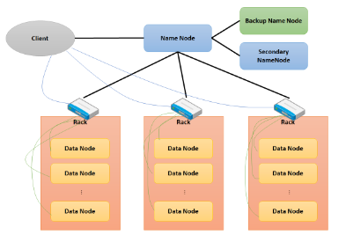


Understanding HDFS Operations
Reading Data
Writing Data
When a client requests a file, the NameNode directs the client to the DataNodes that hold the file's blocks. The client then retrieves the blocks from the corresponding DataNodes, reconstructing the complete file.
When a client writes a file to HDFS, the data is split into blocks and replicated across multiple DataNodes. The NameNode tracks the block locations and ensures data consistency across all replicas.

Slide 5


Essential HDFS Commands
Command
Description
hdfs dfs -ls /
List the contents of a directory.
hdfs dfs -mkdir /user/hadoop/dir
Create a new directory.
hdfs dfs -put localfile.txt /user/hadoop/
Upload a file from the local file system to HDFS.
hdfs dfs -get /user/hadoop/file.txt localdir/
Download a file from HDFS to the local file system.
hdfs dfs -cat /user/hadoop/file.txt
View the contents of a file.

Slide 6


Data Management in HDFS
Command
Description
hdfs dfs -rm /user/hadoop/file.txt
Delete a file.
hdfs dfs -rm -r /user/hadoop/dir/
Delete a directory recursively.
hdfs dfs -stat /user/hadoop/file.txt
Check file status (size, permissions, etc.).
hdfs dfs -mv /user/hadoop/file1.txt /user/hadoop/file2.txt
Move or rename a file.

Slide 7

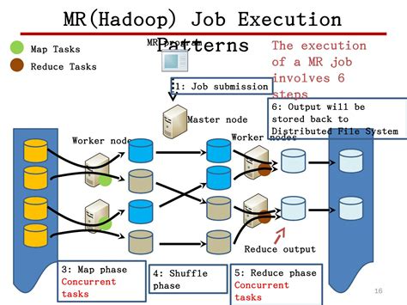
Use Cases and Applications of HDFS
Data Storage for Analytics
HDFS provides a scalable and reliable storage solution for large datasets used in data analytics, enabling organizations to analyze trends, patterns, and insights from massive data volumes.
Batch Processing
HDFS is a cornerstone for batch processing applications. Its ability to store and process data in large batches makes it well-suited for tasks like data aggregation, data transformation, and report generation.
Real-time Data Processing
With the integration of tools like Apache Kafka, HDFS can handle real-time data streams, enabling businesses to analyze data as it's generated, facilitating faster decision-making.
Log Storage and Data Archiving
HDFS is used for storing vast amounts of logs generated by applications and systems, providing valuable historical data for troubleshooting, security audits, and performance analysis.

Slide 8






The Future of HDFS
Cloud Integration
HDFS is increasingly integrating with cloud storage solutions like AWS S3, Google Cloud Storage, and Azure Blob Storage, offering flexibility, scalability, and cost-effectiveness.
Enhanced Security
With advancements in security measures, HDFS is becoming more secure, with features like encryption and access controls to protect sensitive data.
Performance Optimizations
Ongoing efforts are focused on optimizing HDFS performance, improving data throughput and reducing latency, especially for real-time data processing.
Evolving Capabilities
HDFS continues to evolve, incorporating new features and enhancements to address the ever-growing demands of Big Data.

